Slide 1


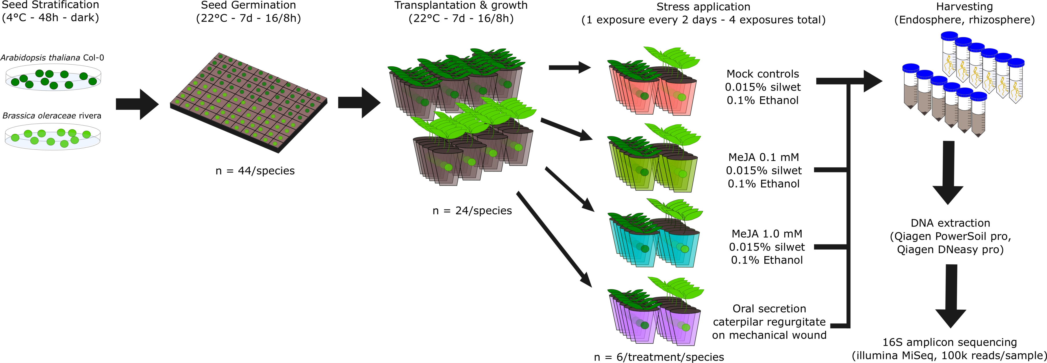
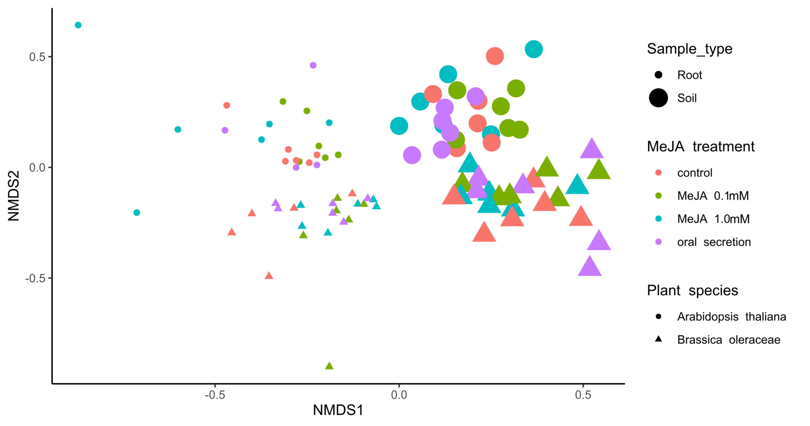
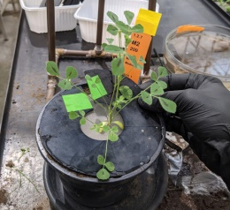
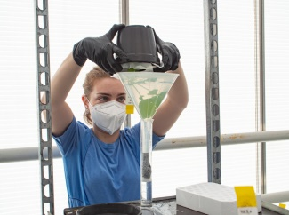
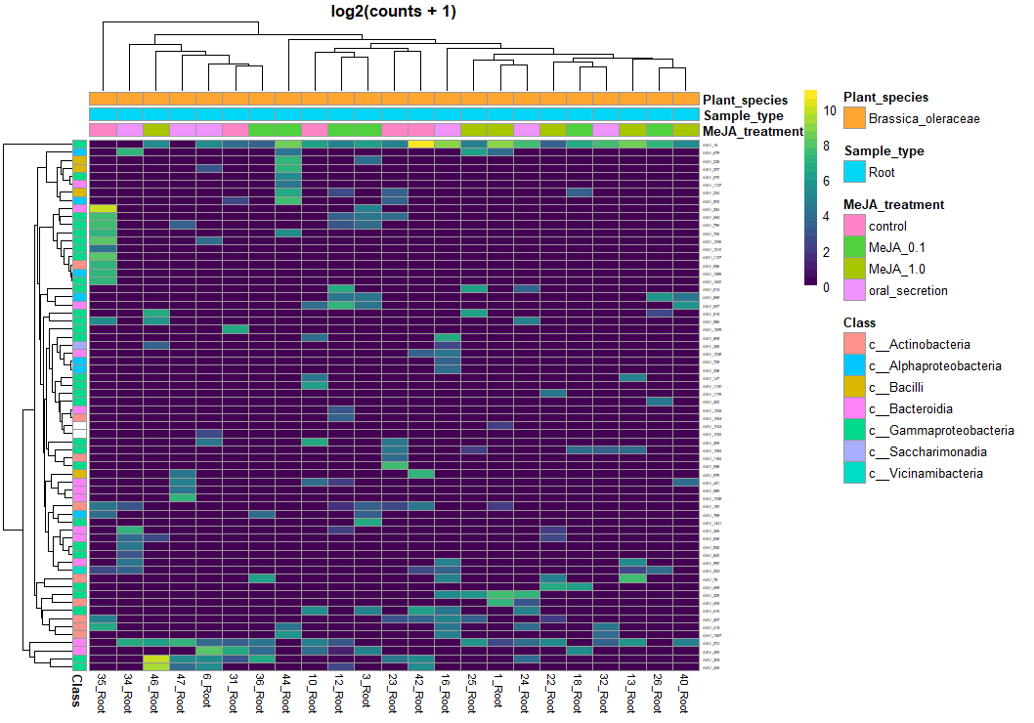
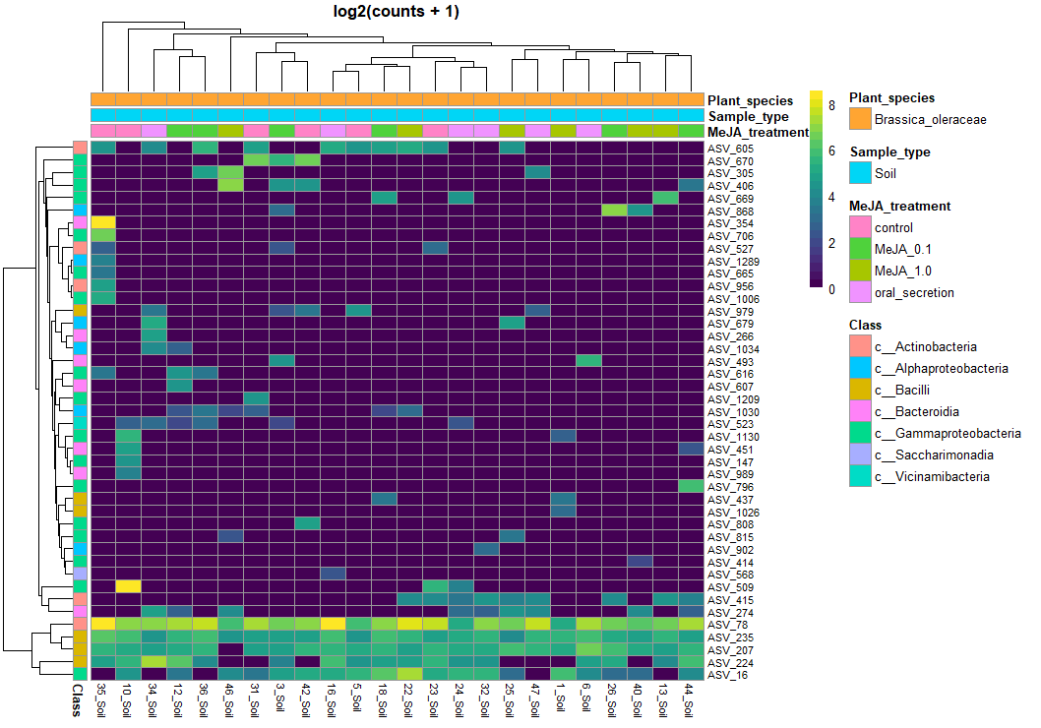
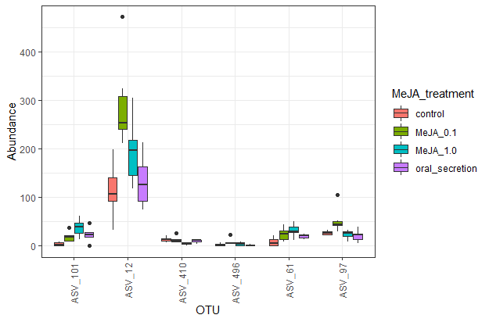
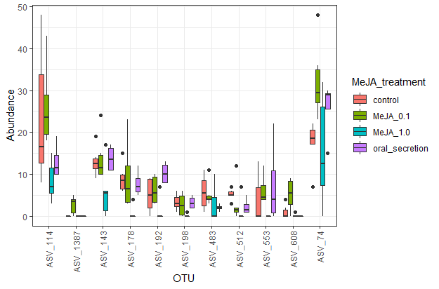
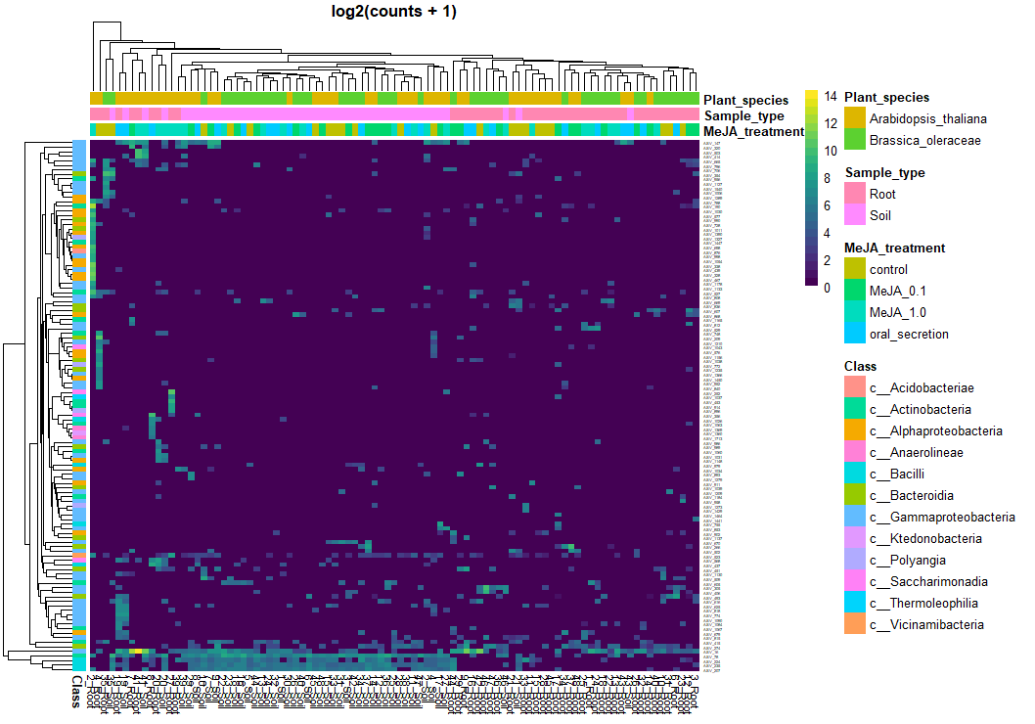
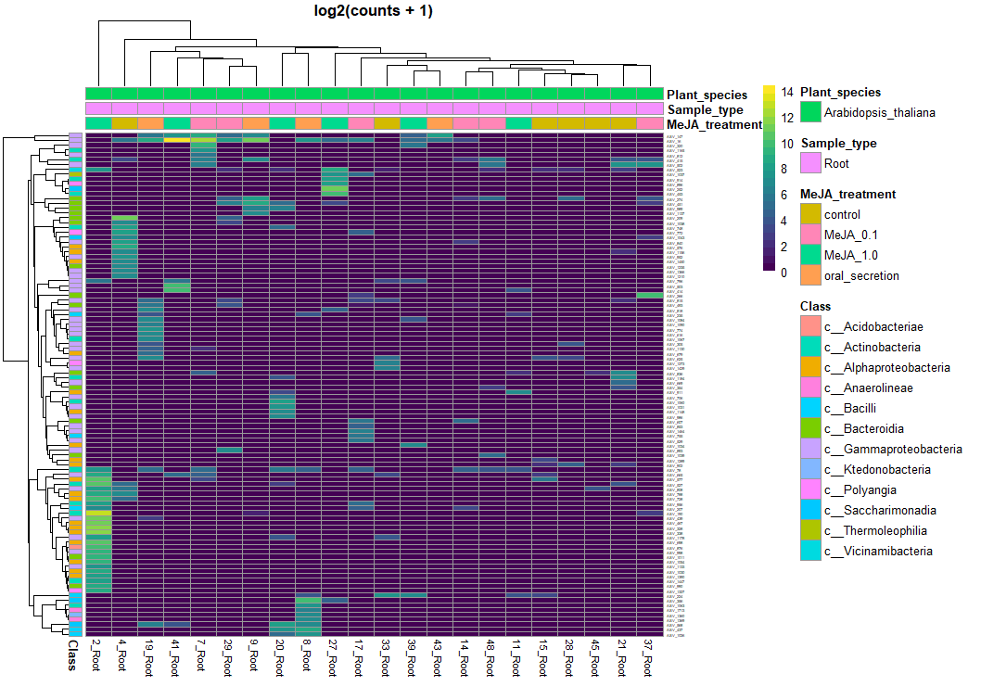
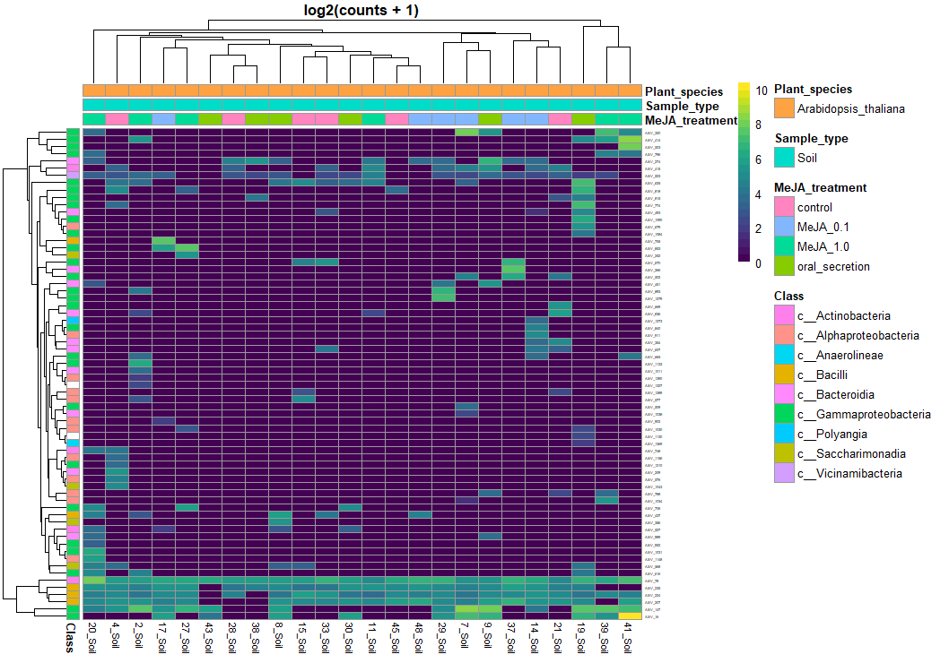
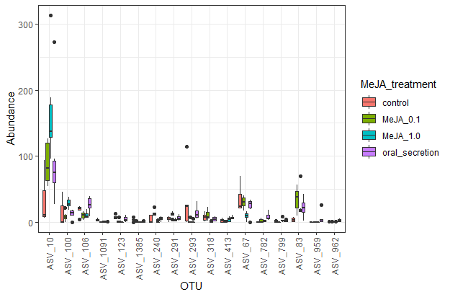
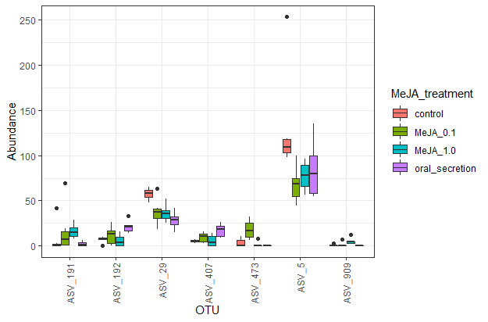
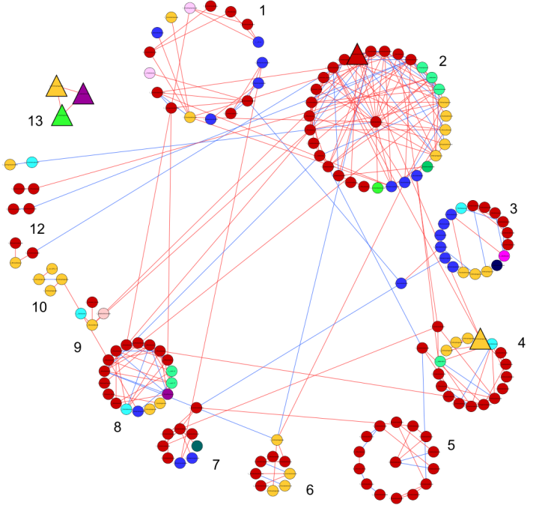
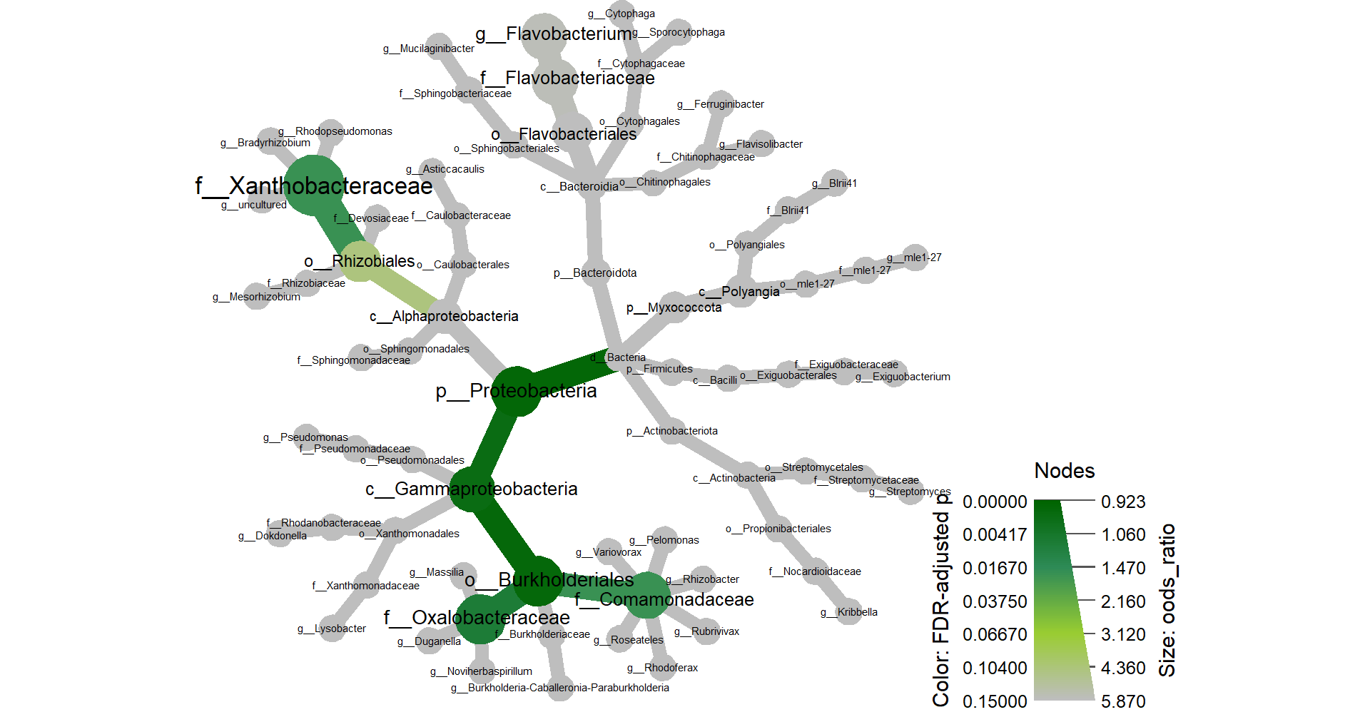
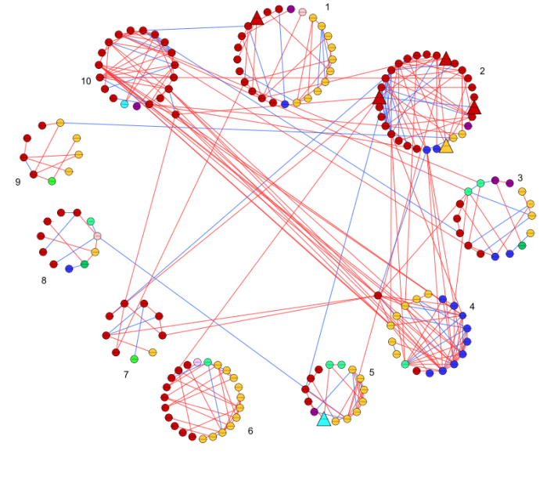
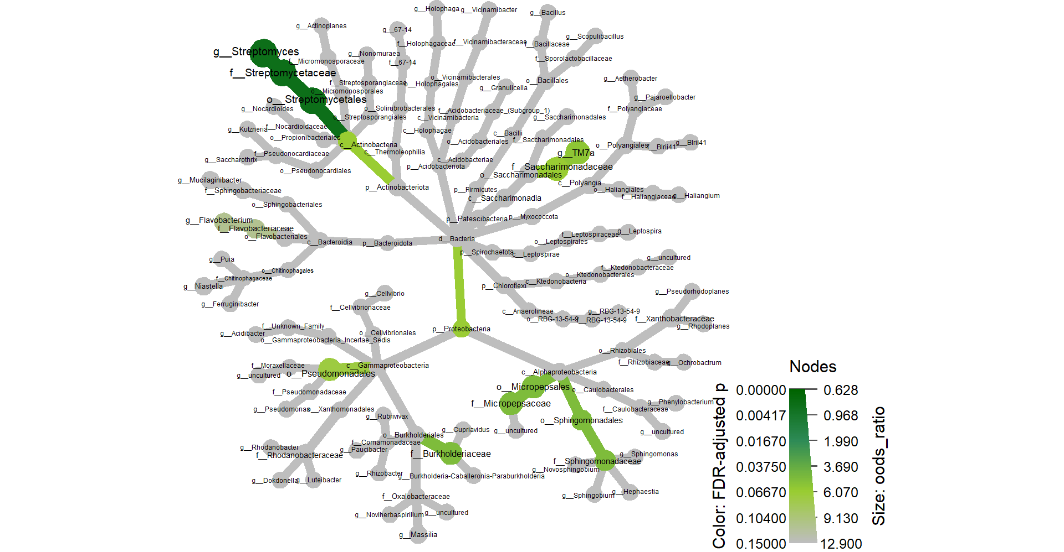
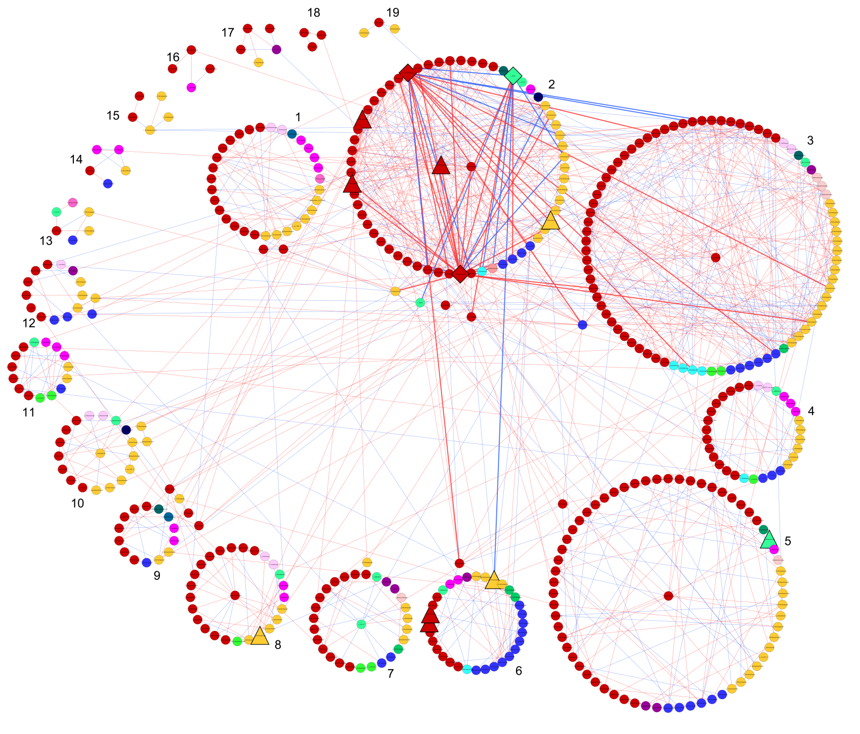
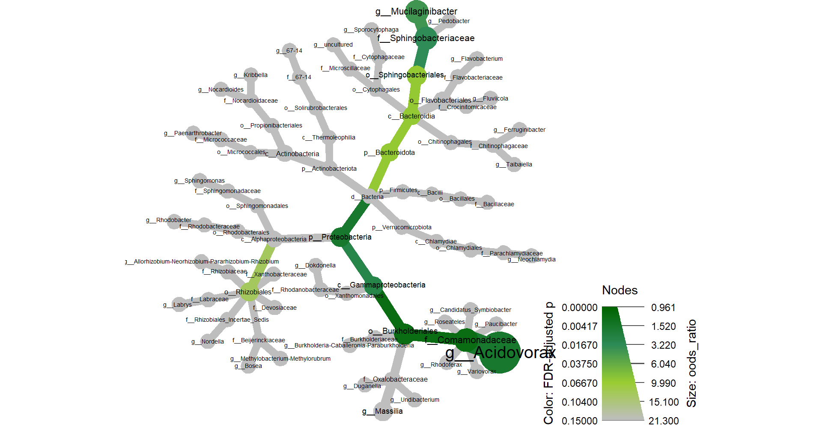
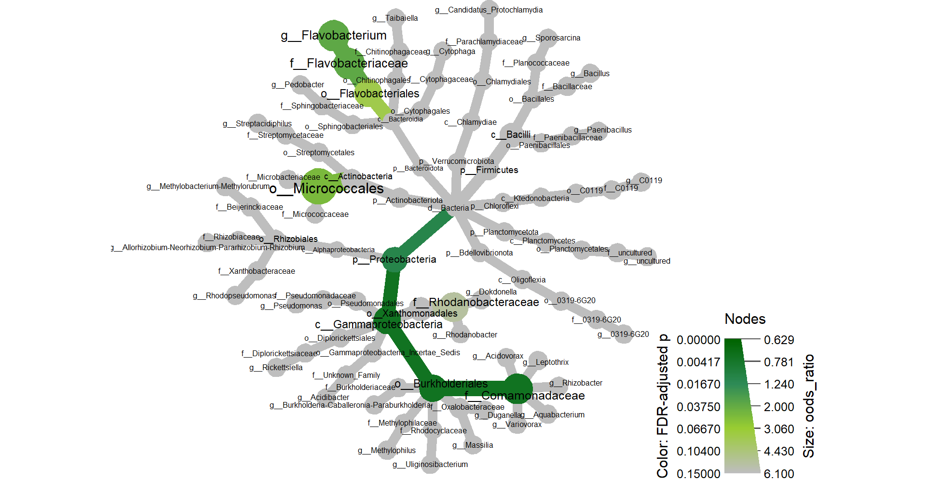
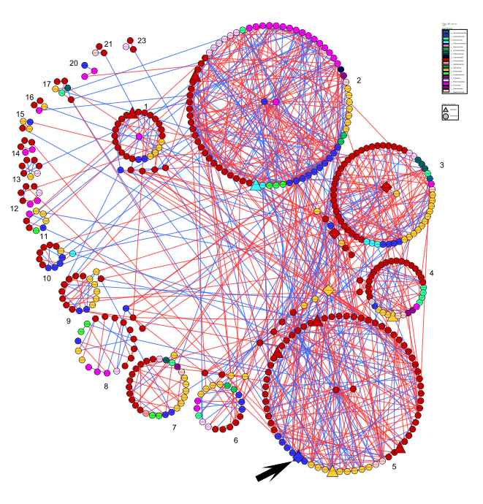
Brassicaceae microbiome response to insect herbivory: summarizing random forest, network analysis, and differential abundance
Pedro Beschoren da Costa¹, Marcela Gomez Aragón¹, Zulema Carracedo Lorenzo¹, Karen Kloth¹, Erik Poelman¹, Marcel Dicke¹
Wageningen University and Research, Wageningen, Netherlands
Introduction
Plant-microbe-insect interactions are very complex, but can still be exploited for sustainable agriculture. Data from microbial community sequencing is also complex, despite the numerous analytical tools available. While access to machine learning or network construction algorithms to analyze such data is not a limiting factor, finding a comprehensive pattern in the analysis output can still be very challenging. Here we apply different analytical methods to microbial communities of Brassicaceae plants under herbivory stress, and then summarize the multi-method outputs into a single figure
Material and methods
We exposed Aradopsis thaliana and Brassica oleraceae to Methyl Jasmonate, a mimics of herbivory stress (Figure 1). We then performed 16S sequencing of plants roots and rhizospheric soil (figure 2). The microbiome dataset was partitioned and processed in R with Boruta for random forest, SPIEC-EASY for network analysis, and Deseq2 for differential abundance.This generated a list of 346 ASVs that were “tagged” as “important”. A fisher test was then used to compare the proportions of every taxonomic level in this list against the proportions of the same taxonomic level in the rest of the dataset. This output is summarized in a heat tree
Results
Figure 2: NMDS ordination of microbial communities. Data was normalized with Cumulative Sum Scaling. There was a very clear effect of plant species and sample type (Endosphere or rhizosphere) but treatment effects were subtle. We proceed the analysis by partitioning the data 4, so that plant species and sample type effects do not mask treatment effects
(b)
(a)
Figure 1: Scheme of the experimental design (a); representation of the MeJA dipping process (b)
AT Root (n=22) 11 of 2690 ASVs |  | Reference
 |  | Control | MeJA 0.1 | MeJA 1.0 | Oral
Prediction | Control | 22 | 5.1 | 2.8 | 5.3
 | MeJA 0.1 | 0.3 | 21.3 | 0 | 0
 | MeJA 1.0 | 0 | 0.8 | 24.5 | 0
 | Oral | 4.8 | 0.1 | 0 | 12.9
 |  | Accuracy: 0.8086 |  | Kappa: 0.7426
AT Root (n=22) 11 of 2690 ASVs |  | Reference
 |  | Control | MeJA 0.1 | MeJA 1.0 | Oral
Prediction | Control | 22 | 5.1 | 2.8 | 5.3
 | MeJA 0.1 | 0.3 | 21.3 | 0 | 0
 | MeJA 1.0 | 0 | 0.8 | 24.5 | 0
 | Oral | 4.8 | 0.1 | 0 | 12.9
 |  | Accuracy: 0.8086 |  | Kappa: 0.7426
AT_root (n=22) 11 out of 2690 |  | Reference
 |  | Control | MeJA 0.1 | MeJA 1.0 | Oral
Prediction | Control | 22 | 5.1 | 2.8 | 5.3
 | MeJA 0.1 | 0.3 | 21.3 | 0 | 0
 | MeJA 1.0 | 0 | 0.8 | 24.5 | 0
 | Oral | 4.8 | 0.1 | 0 | 12.9
​ | ​ ASV tagged as important​ ​ | ASV not tagged as important​ | Total (R)​
ASV in genus​ Mucilaginibacter​ ​ | 5​ | 57​ | 62​
ASV in othergenus​ ​ | 48​ | 2442​ | 2490​
Total (C)​ | 53​ | 2499​ | 2557​
AT Root (n=22) 11 of 2690 ASVs |  | Reference
 |  | Control | MeJA 0.1 | MeJA 1.0 | Oral
Prediction | Control | 22 | 5.1 | 2.8 | 5.3
 | MeJA 0.1 | 0.3 | 21.3 | 0 | 0
 | MeJA 1.0 | 0 | 0.8 | 24.5 | 0
 | Oral | 4.8 | 0.1 | 0 | 12.9
 |  | Accuracy: 0.8086 |  | Kappa: 0.7426
AT Root (n=22) 11 of 2690 ASVs |  | Reference
 |  | Control | MeJA 0.1 | MeJA 1.0 | Oral
Prediction | Control | 22 | 5.1 | 2.8 | 5.3
 | MeJA 0.1 | 0.3 | 21.3 | 0 | 0
 | MeJA 1.0 | 0 | 0.8 | 24.5 | 0
 | Oral | 4.8 | 0.1 | 0 | 12.9
 |  | Accuracy: 0.8086 |  | Kappa: 0.7426
Figure 3: Random forest output showing the confusion matrix (table to the left) and the abundance of ASVs selected by boruta as predictors for stress treatment in each data partition (right). AT = Arabdopsis thaliana, BO = Brassica oleraceae.
Arabdopsis thaliana roots

Slide 2

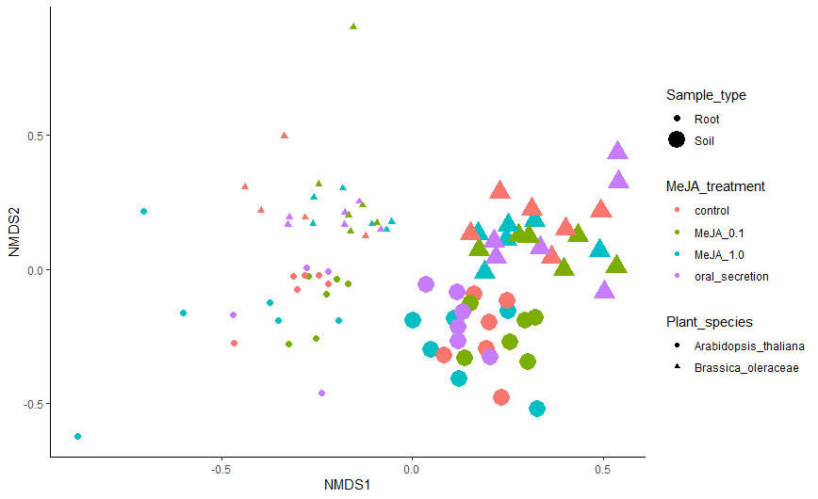
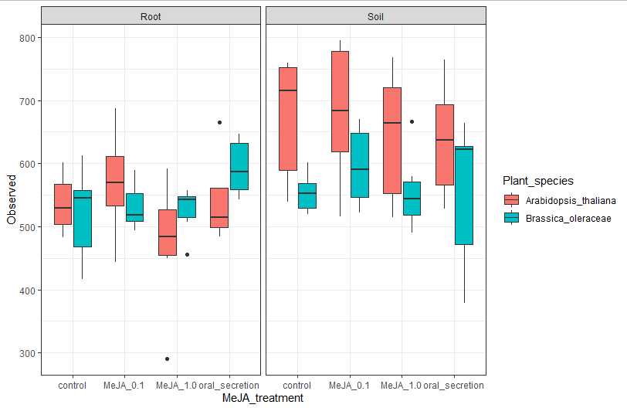
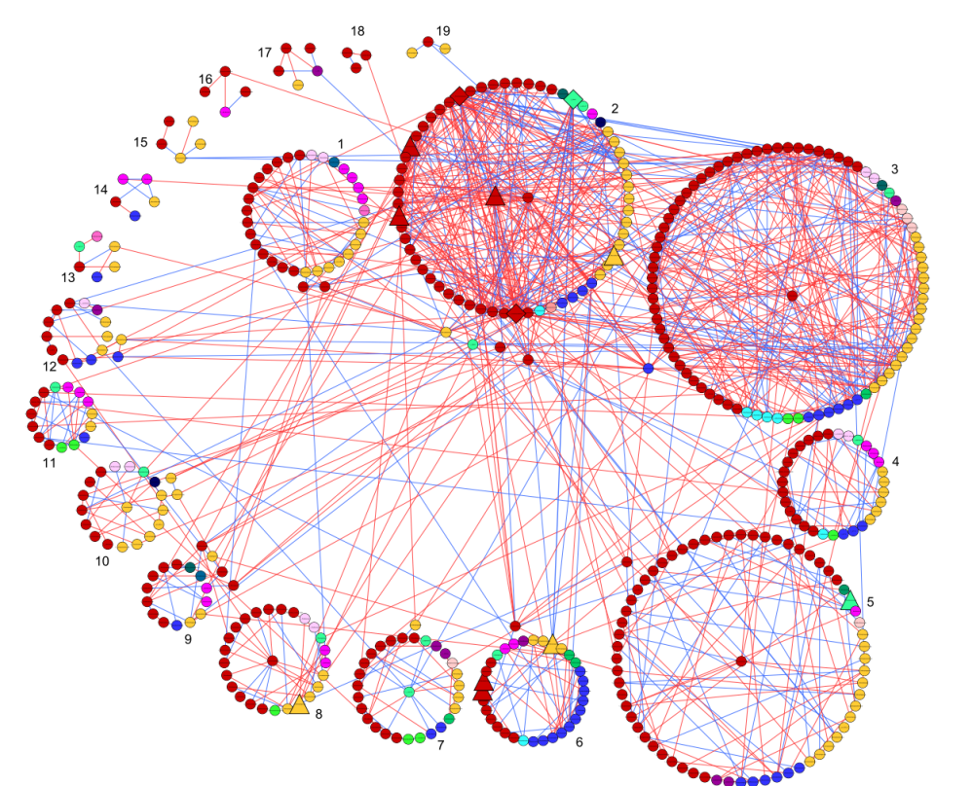
Brassicaceae microbiome response to insect herbivory: summarizing random forest, network analysis, and differential abundance
Pedro Beschoren da Costa¹, Marcela Gomez Aragón¹, Zulema Carracedo Lorenzo¹, Karen Kloth¹, Erik Poelman¹, Marcel Dicke¹
Wageningen University and Research, Wageningen, Netherlands
Introduction
Plant-microbe-insect interactiosn are very complex, but can still be exploited for sustainable agriculture. Here, we expose two Brassicaceae species, Aradopsis thaliana Col-0 and Brassica oleraceae rivera to Methyl Jasmonate, a mimcis of herbivory stress, and then profiled the bacterial communities with amplicon sequencing in the MiSeq platform.
Material and methods
Plant-microbe-insect interactiosn are very complex, but can still be exploited for sustainable agriculture. Here, we expose two Brassicaceae species, Aradopsis thaliana Col-0 and Brassica oleraceae rivera to Methyl Jasmonate, a mimcis of herbivory stress, and then profiled the bacterial communities with amplicon sequencing in the MiSeq platform.
Plant-microbe-insect interactiosn are very complex, but can still be exploited for sustainable agriculture. Here, we expose two Brassicaceae species, Aradopsis thaliana Col-0 and Brassica oleraceae rivera to Methyl Jasmonate, a mimcis of herbivory stress, and then profiled the bacterial communities with amplicon sequencing in the MiSeq platform.
Sowing + germination
Transplant & growth
MeJA application
Harvest & processing
Seed stratification (4C)
(12)
(12)
(12)
(12)
(12)
(12)
(12)
Soil conditioning
50 seeds/species 6 species: 300 seeds
12pots/species 7 species: 84 pots
6. Phenological stages over time (BBCH scale, number of leaves)
(6)
(6)
8. Plant traits;
Non-destructive & Destructive: Shoot and root biomass, root shape
1. Germination efficiency (%)
2. Time for cotyledon emergence
3. Seedling height before transplantation
4. Timing before transplantation 5. Transplantation success (%)
7. Plant traits;
Non-destructive: height, longest leaf
Dipping in 0.015% Silwet 2x/week for 2 weeks
Week 44-45
Week 46
Week 47
Week 48-51
8. Phenotypic response to MeJA
Week 50-51
7 days
2 days
7-? days
14-21(?) days
2 weeks
48hrs
Per round → around 7 weeks
Tentative list of 34 species → 6 rounds
Round 1 + 2 sown this week: End by week 51-52
Plant-microbe-insect interactiosn are very complex, but can still be exploited for sustainable agriculture. Here, we expose two Brassicaceae
Arabdopsis thaliana roots
Arabdopsis thaliana roots
AT_root | Control | MeJA 0,1 | MeJA 1,0 | Oral
Control | 22 | 5,1 | 2,8 | 5,3
MeJA 0,1 | 0,3 | 21,3 | 0 | 0
MeJA 1,0 | 0 | 0,8 | 24,5 | 0
Oral | 4,8 | 0,1 | 0 | 12,9
AT_root | Control | MeJA 0,1 | MeJA 1,0 | Oral
Control | 22 | 5,1 | 2,8 | 5,3
MeJA 0,1 | 0,3 | 21,3 | 0 | 0
MeJA 1,0 | 0 | 0,8 | 24,5 | 0
Oral | 4,8 | 0,1 | 0 | 12,9
Arabdopsis thaliana roots
Arabdopsis thaliana roots
Arabdopsis thaliana roots
Arabdopsis thaliana roots
AT_root | Control | MeJA 0,1 | MeJA 1,0 | Oral
Control | 22 | 5,1 | 2,8 | 5,3
MeJA 0,1 | 0,3 | 21,3 | 0 | 0
MeJA 1,0 | 0 | 0,8 | 24,5 | 0
Oral | 4,8 | 0,1 | 0 | 12,9
​ | ​ ASV tagged as important​ ​ | ASV not tagged as important​ | Total (R)​
ASV in genus​ Mucilaginibacter​ ​ | 5​ | 57​ | 62​
ASV in othergenus​ ​ | 48​ | 2442​ | 2490​
Total (C)​ | 53​ | 2499​ | 2557​
AT_root | Control | MeJA 0,1 | MeJA 1,0 | Oral
Control | 22 | 5,1 | 2,8 | 5,3
MeJA 0,1 | 0,3 | 21,3 | 0 | 0
MeJA 1,0 | 0 | 0,8 | 24,5 | 0
Oral | 4,8 | 0,1 | 0 | 12,9
Plant-microbe-insect interactiosn are very complex, but can still be exploited for sustainable agriculture. Here, we expose two Brassicaceae species, Aradopsis thaliana Col-0 and Brassica oleraceae rivera to Methyl Jasmonate, a mimcis of herbivory stress, and then profiled the bacterial communities with amplicon sequencing in the MiSeq platform.

Slide 3
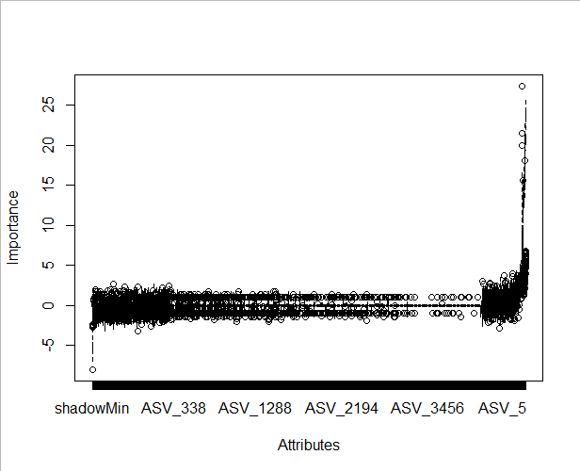
Brassicaceae microbiome response to insect herbivory: summarizing random forest, network analysis, and differential abundance
Pedro Beschoren da Costa¹, Marcela Gomez Aragón¹, Zulema Carracedo Lorenzo¹, Karen Kloth¹, Erik Poelman¹, Marcel Dicke¹
Wageningen University and Research, Wageningen, Netherlands
Introduction
Plant-microbe-insect interactiosn are very complex, but can still be exploited for sustainable agriculture. Here, we expose two Brassicaceae species, Aradopsis thaliana Col-0 and Brassica oleraceae rivera to Methyl Jasmonate, a mimcis of herbivory stress, and then profiled the bacterial communities with amplicon sequencing in the MiSeq platform.
Material and methods
Plant-microbe-insect interactiosn are very complex, but can still be exploited for sustainable agriculture. Here, we expose two Brassicaceae species, Aradopsis thaliana Col-0 and Brassica oleraceae rivera to Methyl Jasmonate, a mimcis of herbivory stress, and then profiled the bacterial communities with amplicon sequencing in the MiSeq platform.
Sowing + germination
Transplant & growth
MeJA application
Harvest & processing
Seed stratification (4C)
(12)
(12)
(12)
(12)
(12)
(12)
(12)
Soil conditioning
50 seeds/species 6 species: 300 seeds
12pots/species 7 species: 84 pots
6. Phenological stages over time (BBCH scale, number of leaves)
(6)
(6)
8. Plant traits;
Non-destructive & Destructive: Shoot and root biomass, root shape
1. Germination efficiency (%)
2. Time for cotyledon emergence
3. Seedling height before transplantation
4. Timing before transplantation 5. Transplantation success (%)
7. Plant traits;
Non-destructive: height, longest leaf
Dipping in 0.015% Silwet 2x/week for 2 weeks
Week 44-45
Week 46
Week 47
Week 48-51
8. Phenotypic response to MeJA
Week 50-51
7 days
2 days
7-? days
14-21(?) days
2 weeks
48hrs
Per round → around 7 weeks
Tentative list of 34 species → 6 rounds
Round 1 + 2 sown this week: End by week 51-52
Fisher Summary
Random forest
Network
analysis
Differential
abudance
AT_root | Control | MeJA 0,1 | MeJA 1,0 | Oral
Control | 22 | 5,1 | 2,8 | 5,3
MeJA 0,1 | 0,3 | 21,3 | 0 | 0
MeJA 1,0 | 0 | 0,8 | 24,5 | 0
Oral | 4,8 | 0,1 | 0 | 12,9
Arabdopsis thaliana roots
AT_root | Control | MeJA 0,1 | MeJA 1,0 | Oral
Control | 22 | 5,1 | 2,8 | 5,3
MeJA 0,1 | 0,3 | 21,3 | 0 | 0
MeJA 1,0 | 0 | 0,8 | 24,5 | 0
Oral | 4,8 | 0,1 | 0 | 12,9
Arabdopsis thaliana roots
AT_root | Control | MeJA 0,1 | MeJA 1,0 | Oral
Control | 22 | 5,1 | 2,8 | 5,3
MeJA 0,1 | 0,3 | 21,3 | 0 | 0
MeJA 1,0 | 0 | 0,8 | 24,5 | 0
Oral | 4,8 | 0,1 | 0 | 12,9
Arabdopsis thaliana roots
AT_root | Control | MeJA 0,1 | MeJA 1,0 | Oral
Control | 22 | 5,1 | 2,8 | 5,3
MeJA 0,1 | 0,3 | 21,3 | 0 | 0
MeJA 1,0 | 0 | 0,8 | 24,5 | 0
Oral | 4,8 | 0,1 | 0 | 12,9
Arabdopsis thaliana roots
Plant-microbe-insect interactiosn are very complex, but can still be exploited for sustainable agriculture. Here, we expose two Brassicaceae species, Aradopsis thaliana Col-0 and Brassica oleraceae rivera to Methyl Jasmonate, a mimcis of herbivory stress, and then profiled the bacterial communities with amplicon sequencing in the MiSeq platform.
​ | ​ ASV tagged as important​ ​ | ASV not tagged as important​ | Total (R)​
ASV in genus​ Mucilaginibacter​ ​ | 5​ | 57​ | 62​
ASV in othergenus​ ​ | 48​ | 2442​ | 2490​
Total (C)​ | 53​ | 2499​ | 2557​
Plant-microbe-insect interactiosn are very complex, but can still be exploited for sustainable agriculture. Here, we expose two Brassicaceae species, Aradopsis thaliana Col-0 and Brassica oleraceae rivera to Methyl Jasmonate, a mimcis of herbivory stress, and then profiled the bacterial communities with amplicon sequencing in the MiSeq platform.

Slide 4
Brassicaceae microbiome response to insect herbivory: summarizing random forest, network analysis, and differential abundance
Pedro Beschoren da Costa¹, Marcela Gomez Aragón¹, Zulema Carracedo Lorenzo¹, Karen Kloth¹, Erik Poelman¹, Marcel Dicke¹
Wageningen University and Research, Wageningen, Netherlands
Introduction
Plant-microbe-insect interactiosn are very complex, but can still be exploited for sustainable agriculture. Here, we expose two Brassicaceae species, Aradopsis thaliana Col-0 and Brassica oleraceae rivera to Methyl Jasmonate, a mimcis of herbivory stress, and then profiled the bacterial communities with amplicon sequencing in the MiSeq platform.
Material and methods
Plant-microbe-insect interactiosn are very complex, but can still be exploited for sustainable agriculture. Here, we expose two Brassicaceae species, Aradopsis thaliana Col-0 and Brassica oleraceae rivera to Methyl Jasmonate, a mimcis of herbivory stress, and then profiled the bacterial communities with amplicon sequencing in the MiSeq platform.
Sowing + germination
Transplant & growth
MeJA application
Harvest & processing
Seed stratification (4C)
(12)
(12)
(12)
(12)
(12)
(12)
(12)
Soil conditioning
50 seeds/species 6 species: 300 seeds
12pots/species 7 species: 84 pots
6. Phenological stages over time (BBCH scale, number of leaves)
(6)
(6)
8. Plant traits;
Non-destructive & Destructive: Shoot and root biomass, root shape
1. Germination efficiency (%)
2. Time for cotyledon emergence
3. Seedling height before transplantation
4. Timing before transplantation 5. Transplantation success (%)
7. Plant traits;
Non-destructive: height, longest leaf
Dipping in 0.015% Silwet 2x/week for 2 weeks
Week 44-45
Week 46
Week 47
Week 48-51
8. Phenotypic response to MeJA
Week 50-51
7 days
2 days
7-? days
14-21(?) days
2 weeks
48hrs
Per round → around 7 weeks
Tentative list of 34 species → 6 rounds
Round 1 + 2 sown this week: End by week 51-52
Arabdopsis thaliana roots
Arabdopsis thaliana roots
AT_root | Control | MeJA 0,1 | MeJA 1,0 | Oral
Control | 22 | 5,1 | 2,8 | 5,3
MeJA 0,1 | 0,3 | 21,3 | 0 | 0
MeJA 1,0 | 0 | 0,8 | 24,5 | 0
Oral | 4,8 | 0,1 | 0 | 12,9
AT_root | Control | MeJA 0,1 | MeJA 1,0 | Oral
Control | 22 | 5,1 | 2,8 | 5,3
MeJA 0,1 | 0,3 | 21,3 | 0 | 0
MeJA 1,0 | 0 | 0,8 | 24,5 | 0
Oral | 4,8 | 0,1 | 0 | 12,9
AT_root | Control | MeJA 0,1 | MeJA 1,0 | Oral
Control | 22 | 5,1 | 2,8 | 5,3
MeJA 0,1 | 0,3 | 21,3 | 0 | 0
MeJA 1,0 | 0 | 0,8 | 24,5 | 0
Oral | 4,8 | 0,1 | 0 | 12,9
AT_root | Control | MeJA 0,1 | MeJA 1,0 | Oral
Control | 22 | 5,1 | 2,8 | 5,3
MeJA 0,1 | 0,3 | 21,3 | 0 | 0
MeJA 1,0 | 0 | 0,8 | 24,5 | 0
Oral | 4,8 | 0,1 | 0 | 12,9
Arabdopsis thaliana roots
Arabdopsis thaliana roots
Plant-microbe-insect interactiosn are very complex, but can still be exploited for sustainable agriculture. Here, we expose two Brassicaceae species, Aradopsis thaliana Col-0 and Brassica oleraceae rivera to Methyl Jasmonate, a mimcis of herbivory stress, and then profiled the bacterial communities with amplicon sequencing in the MiSeq platform.
​ | ​ ASV tagged as important​ ​ | ASV not tagged as important​ | Total (R)​
ASV in genus​ Mucilaginibacter​ ​ | 5​ | 57​ | 62​
ASV in othergenus​ ​ | 48​ | 2442​ | 2490​
Total (C)​ | 53​ | 2499​ | 2557​
Plant-microbe-insect interactiosn are very complex, but can still be exploited for sustainable agriculture. Here, we expose two Brassicaceae species, Aradopsis thaliana Col-0 and Brassica oleraceae rivera to Methyl Jasmonate, a mimcis of herbivory stress, and then profiled the bacterial communities with amplicon sequencing in the MiSeq platform.

Slide 5
Brassicaceae microbiome response to insect herbivory: summarizing random forest, network analysis, and differential abundance
Pedro Beschoren da Costa¹, Marcela Gomez Aragón¹, Zulema Carracedo Lorenzo¹, Karen Kloth¹, Erik Poelman¹, Marcel Dicke¹
Wageningen University and Research, Wageningen, Netherlands
Introduction
Plant-microbe-insect interactiosn are very complex, but can still be exploited for sustainable agriculture. Here, we expose two Brassicaceae species, Aradopsis thaliana Col-0 and Brassica oleraceae rivera to Methyl Jasmonate, a mimcis of herbivory stress, and then profiled the bacterial communities with amplicon sequencing in the MiSeq platform.
Material and methods
Plant-microbe-insect interactiosn are very complex, but can still be exploited for sustainable agriculture. Here, we expose two Brassicaceae species, Aradopsis thaliana Col-0 and Brassica oleraceae rivera to Methyl Jasmonate, a mimcis of herbivory stress, and then profiled the bacterial communities with amplicon sequencing in the MiSeq platform.
Sowing + germination
Transplant & growth
MeJA application
Harvest & processing
Seed stratification (4C)
(12)
(12)
(12)
(12)
(12)
(12)
(12)
Soil conditioning
50 seeds/species 6 species: 300 seeds
12pots/species 7 species: 84 pots
6. Phenological stages over time (BBCH scale, number of leaves)
(6)
(6)
8. Plant traits;
Non-destructive & Destructive: Shoot and root biomass, root shape
1. Germination efficiency (%)
2. Time for cotyledon emergence
3. Seedling height before transplantation
4. Timing before transplantation 5. Transplantation success (%)
7. Plant traits;
Non-destructive: height, longest leaf
Dipping in 0.015% Silwet 2x/week for 2 weeks
Week 44-45
Week 46
Week 47
Week 48-51
8. Phenotypic response to MeJA
Week 50-51
7 days
2 days
7-? days
14-21(?) days
2 weeks
48hrs
Per round → around 7 weeks
Tentative list of 34 species → 6 rounds
Round 1 + 2 sown this week: End by week 51-52
Random forest
AT_root | Control | MeJA 0,1 | MeJA 1,0 | Oral
Control | 22 | 5,1 | 2,8 | 5,3
MeJA 0,1 | 0,3 | 21,3 | 0 | 0
MeJA 1,0 | 0 | 0,8 | 24,5 | 0
Oral | 4,8 | 0,1 | 0 | 12,9
AT_root | Control | MeJA 0,1 | MeJA 1,0 | Oral
Control | 22 | 5,1 | 2,8 | 5,3
MeJA 0,1 | 0,3 | 21,3 | 0 | 0
MeJA 1,0 | 0 | 0,8 | 24,5 | 0
Oral | 4,8 | 0,1 | 0 | 12,9
AT_root | Control | MeJA 0,1 | MeJA 1,0 | Oral
Control | 22 | 5,1 | 2,8 | 5,3
MeJA 0,1 | 0,3 | 21,3 | 0 | 0
MeJA 1,0 | 0 | 0,8 | 24,5 | 0
Oral | 4,8 | 0,1 | 0 | 12,9
Arabdopsis thaliana roots
AT_root | Control | MeJA 0,1 | MeJA 1,0 | Oral
Control | 22 | 5,1 | 2,8 | 5,3
MeJA 0,1 | 0,3 | 21,3 | 0 | 0
MeJA 1,0 | 0 | 0,8 | 24,5 | 0
Oral | 4,8 | 0,1 | 0 | 12,9
Arabdopsis thaliana roots
Arabdopsis thaliana roots
Arabdopsis thaliana roots
Plant-microbe-insect interactiosn are very complex, but can still be exploited for sustainable agriculture. Here, we expose two Brassicaceae species, Aradopsis thaliana Col-0 and Brassica oleraceae rivera to Methyl Jasmonate, a mimcis of herbivory stress, and then profiled the bacterial communities with amplicon sequencing in the MiSeq platform.
Network
analysis
Fisher Summary
Differential
abudance
Plant-microbe-insect interactiosn are very complex, but can still be exploited for sustainable agriculture. Here, we expose two Brassicaceae species, Aradopsis thaliana Col-0 and Brassica oleraceae rivera to Methyl Jasmonate, a mimcis of herbivory stress, and then profiled the bacterial communities with amplicon sequencing in the MiSeq platform.
​ | ​ ASV tagged as important​ ​ | ASV not tagged as important​ | Total (R)​
ASV in genus​ Mucilaginibacter​ ​ | 5​ | 57​ | 62​
ASV in othergenus​ ​ | 48​ | 2442​ | 2490​
Total (C)​ | 53​ | 2499​ | 2557​

